Slide 1
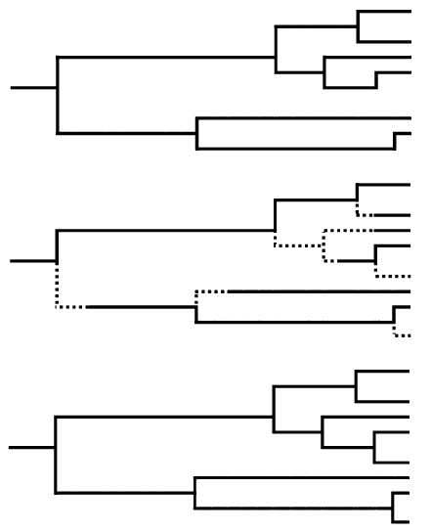
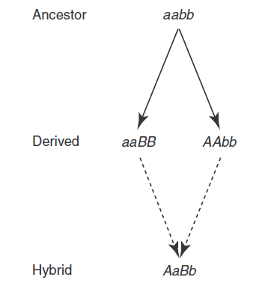
What are the differences in phylogenies based on the protracted birth-death model and the Bateson-Dobzhansky-Müller model?
By Jorik de Boer
Master Ecology and Evolution
October 2016
Supervisor: Richèl Bilderbeek
Notes:
1. Six month project starting in september

Slide 2
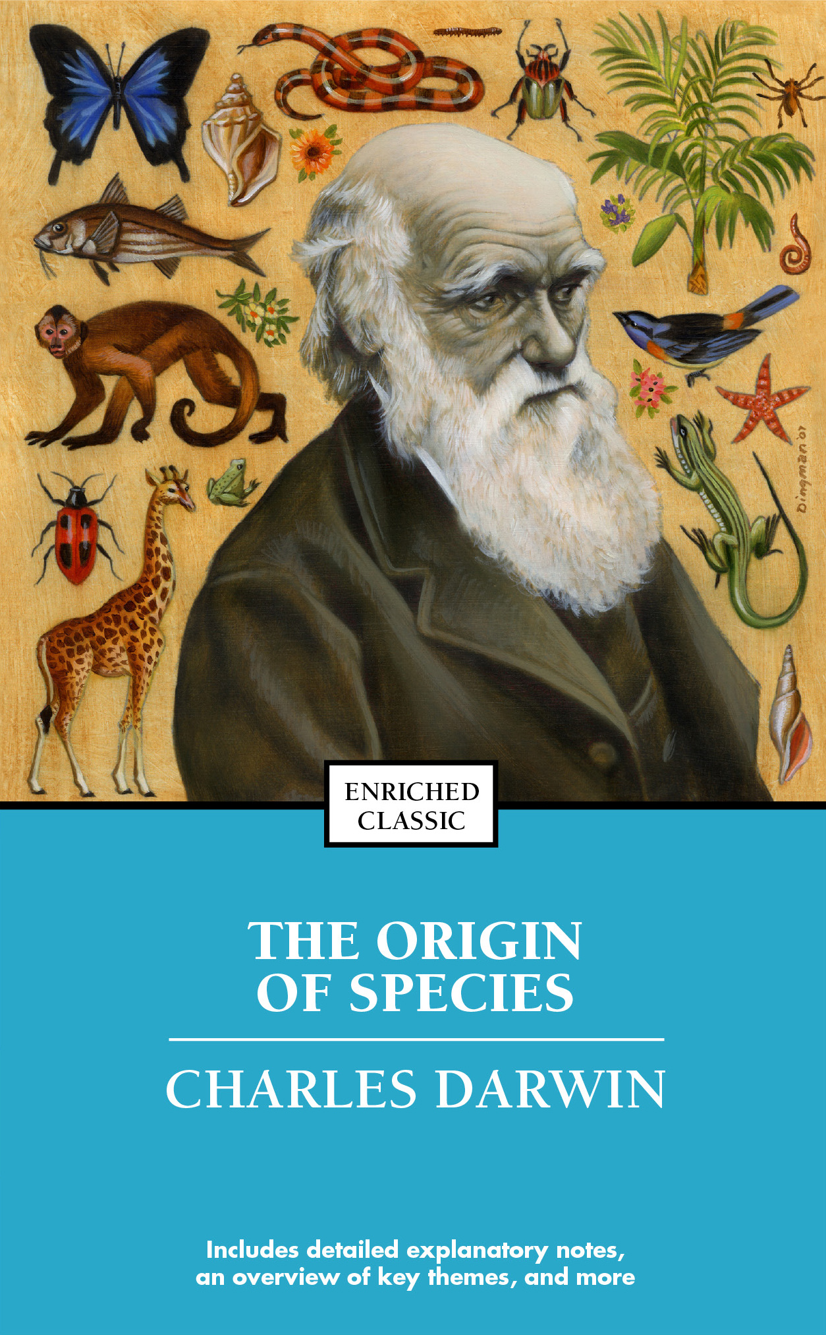
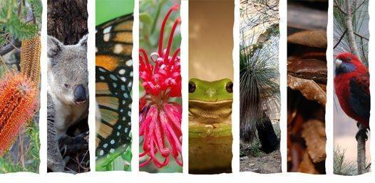
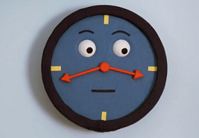
Introduction
Notes:
1. Present day biodiversity, large range of species
2. Which speciation processes did contribute to modern day biodiversity and how does time affect these processes?
3. How long does it take to complete the process of speciation?
4. Multiple diversification models have been created to simulate phylogenies of species, will discuss 3 of them.

Slide 3
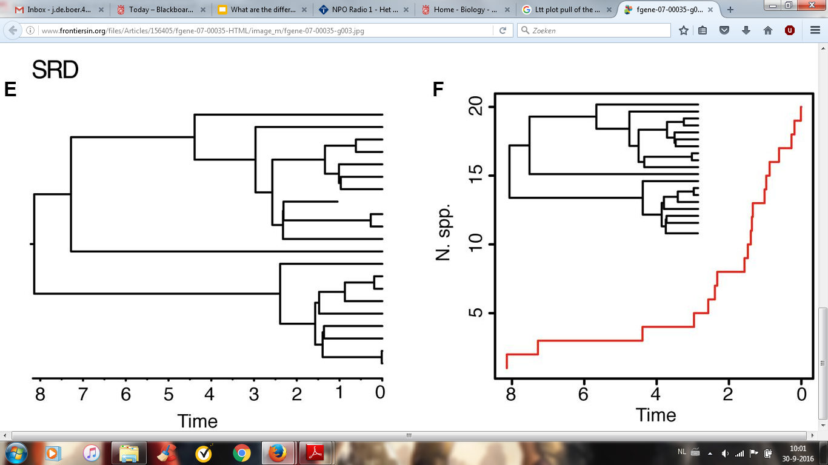

Background speciation models: BD-model
“Pull of the present”
Sanmartin, I. and Meseguer A. S. 2016. Extinction in phylogenetics and biogeography: from timetrees to patterns of biotic assemblage. Frontiers in genetics 7: 35.
Notes:
1. The first speciation model: the standard birth-death model (BD) allows for extinction and birth of species
2. A plot of the number of lineages versus time (lineages through-time (LTT) plot) of the BD-model shows a constant or accelerating increase in the number of lineages towards the present.
3. increase in number of lineages towards the present also called “pull of the present”, caused by recent species: lower chance to become extinct in contrast to older species
4. In LTT plots of phylogenies a decrease of lineages is visible towards the present, inconsistent with the BD-model simulations.

Slide 4
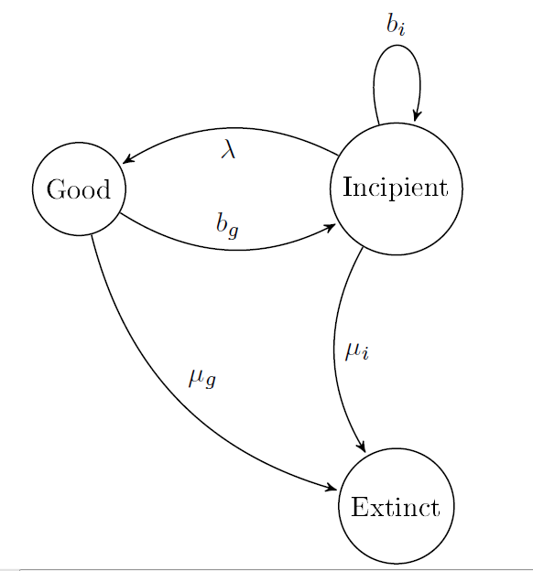
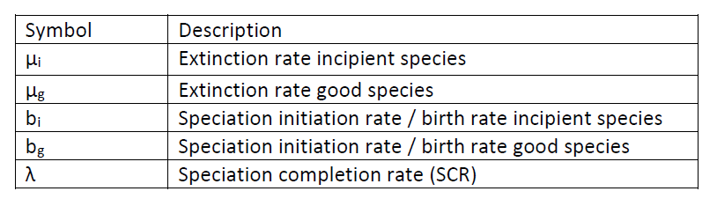
Background speciation models: PBD-model
The protracted birth-death model
Bilderbeek, R. J. C. and Etienne, R. S. Should protracted speciation be incorporated in phylogenetic tree construction methods? Not yet published.
Notes:
1. Second speciation model: The protracted birth-death model (PBD, also called protracted speciation model) tried to implement the concept that the speciation process takes time in the BD-model.
2. Schematic representation of the protracted birth-death model with five parameters
3. If SCR is close to infinity the model is the same as the birth-death model if the extinction rates and birth rates have the same values
4. The model lacks the implementation of a mechanistic process for speciation

Slide 5
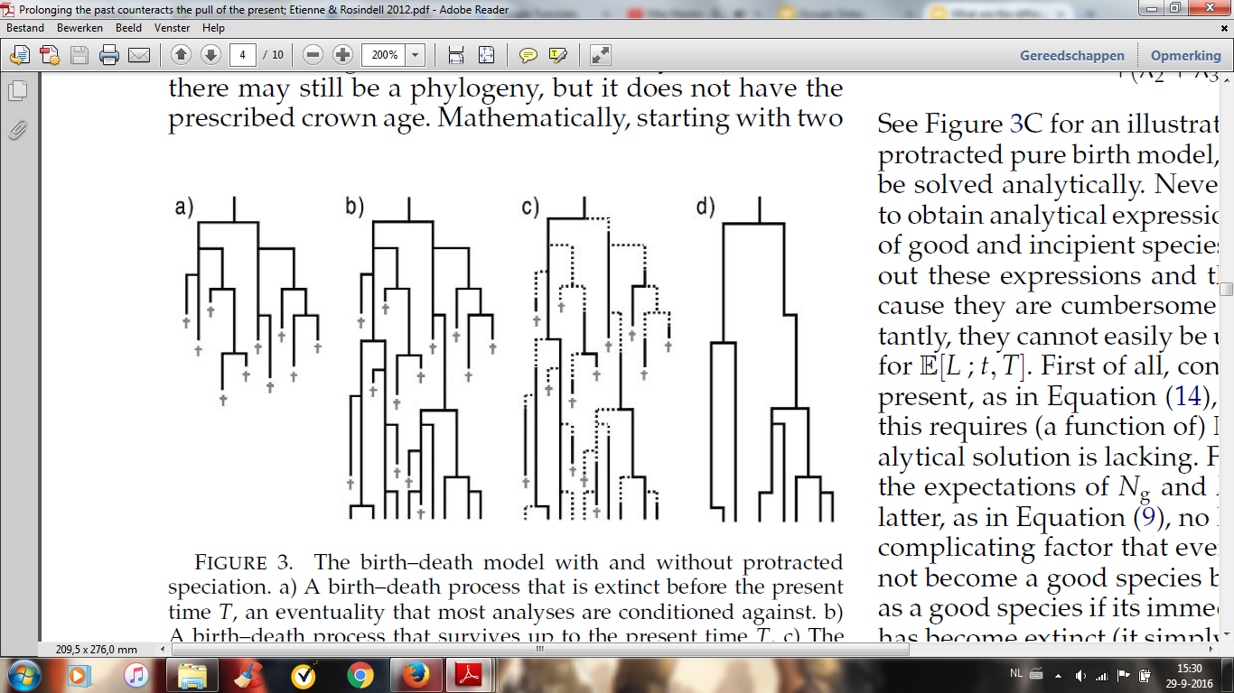
Background speciation models: BD & PBD-model
Etienne, R. S. and Rosindell, J. 2012. Prolonging the past counteracts the pull of the present: protracted speciation can explain observed slowdowns in diversification. Systematic Biology 61: 204-213.
Notes:
1. Phylogenies of the BD-model (a,b) and the PBD-model (c). D gives the phylogeny of the PBD-process in panel c.
2 .For BD-model: recent species: lower chance to become extinct in contrast to older species
3. For PBD-model conversion to phylogeny: Incipient species near the present extinct, except when ancestor/parent got extinct
4. Uses assumptions that we can’t observe the “new” incipient species near the present, leading to an observed decrease of lineages visible towards the present

Slide 6
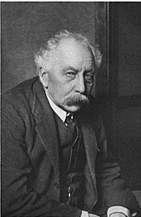
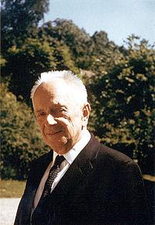
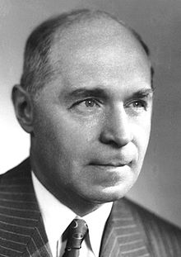
The Bateson-Dobzhansky-Müller model (1)
Cutter, A. D. 2012. The polymorphic prelude to Bateson–Dobzhansky–Muller incompatibilities. Trend in Ecology and Evolution 27: 209-218
Notes:
1. Third speciation model: the Bateson-Dobzhansky-Müller (BDM) model, named after Bateson (1909), Dobzhansky ( independently 1936) and Muller (elaborated 1942)
2. Two-locus, two-allele model, centered around the idea that two alleles at two different loci are incompatible
3. Incompatibility expressed as reduced fitness component, for example fertility, viability, sexual attractiveness (also described in terms of epistatic interactions, lack of functions in hybrids and lack of matching between maternal and paternal genes)

Slide 7
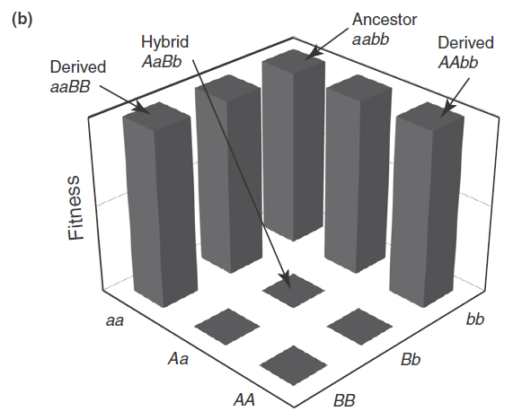
The Bateson-Dobzhansky-Müller model (2)
Cutter, A. D. 2012. The polymorphic prelude to Bateson–Dobzhansky–Muller incompatibilities. Trend in Ecology and Evolution 27: 209-218
Notes:
1. A fitness landscape based on the BDM-model with similar genotypes as in the schematic representation.
2. The model can evolve to strong reproductive isolation (RI) without crossing “fitness valleys”. In the BDM-model species can maintain high fitness during the speciation process, while in other speciation models species need to cross fitness valleys in a vulnerable state of low fitness.
3. According to Gavrilets the simplest example of a “holey fitness landscape”, with a low and a high fitness type

Slide 8
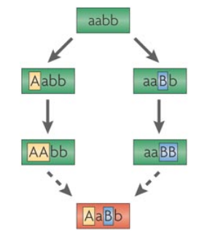
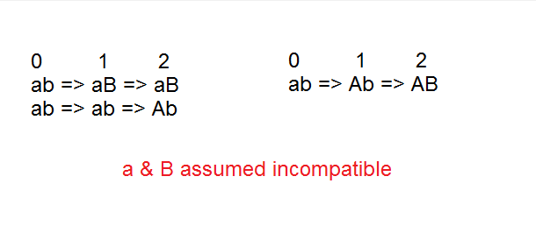
Bateson-Dobzhansky-Müller model characteristics
Two-populations and one-population scenario
Gavrilets, S. 2004. Fitness landscapes and the origin of species. Princeton University Press.
Bomblies K. and Weigel D. 2007. Hybrid necrosis: autoimmunity as a potential gene-flow barrier in plant species. Nature Reviews Genetics 8: 382-393.
Notes:
1. One and two populations scenario, both leading to IR: one-population scenario includes two substitutions evolving in a reproductive isolated state from the original population. The two-population scenario includes two populations including two substitutions at two different loci, evolving in a reproductive isolated state.
2. Possibility and effects backward mutations
3. Possibility for selection for local adaptation: with uniform selection or heterogeneous selection
4. Possibility different mutation rates per loci

Slide 9
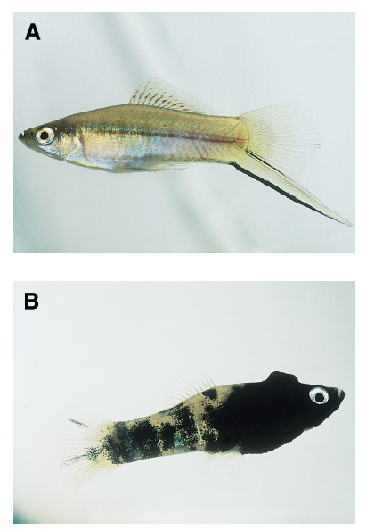
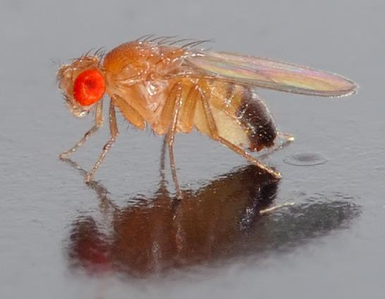
Biological context
Gavrilets, S. 2004. Fitness landscapes and the origin of species. Princeton University Press.
Orr, H. A. and Presgraves D. C. 2000. Speciation by postzygotic isolation: forces, genes and molecules. Bioessays 22: 1085-1094.
Notes:
1. The genotypic mechanisms that characterize the BDM-model can be found in Drosophila and fish species
2. X. Helleri and X. Maculatus crossing causes exaggerated spots in F1 and backcrossed to X.Helleri melnaomas (often lethal) for half of F2
3.Odysseus gene contributes to sterility of hybrid males by crosses D. Simuls and D. Mauritiana, more fruit fly examples

Slide 10
Research Question
What are the differences in phylogenies based on the protracted birth-death model (PBD) and the Bateson-Dobzhansky-Müller model (BDM)?
- What are the possibilities to compare and qualify the
Differences and similarities between phylogenetic trees?
- Which assumptions are you going to use for your BDM-model?
Notes:
1. Research question
2. First model BDM-model in Cpp to create phylogenetic trees
3.Compare phylgenetic trees of PBD and BDM with summary statistics
4. Differences and similarities between the phylogenies of both models can give more information about the usability of a mechanistic model including time consuming speciation (explain the decrease of lineages in LTT plots of phylogenies towards the present)
5. How to compare phylogenetic trees, which assumptions are used?

Slide 11
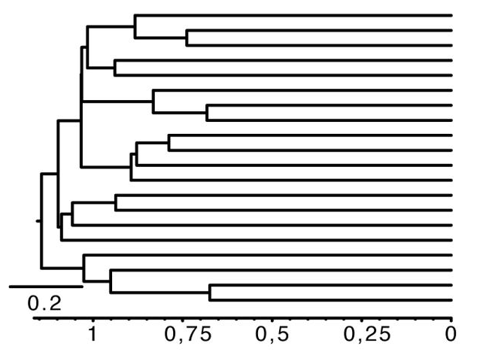
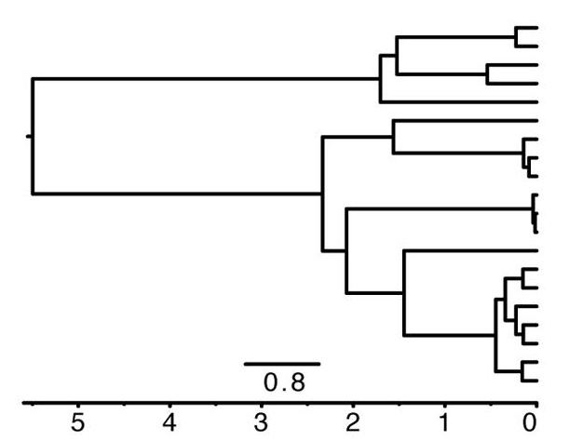
Summary statistics (1)
Gamma (γ) summary statistic, tree size and the Phylogenetic Diversity metric (PD)
Sanmartin, I. and Meseguer A. S. 2016. Extinction in phylogenetics and biogeography: from timetrees to patterns of biotic assemblage. Frontiers in genetics 7: 35.
Notes:
1. The gamma summary statistic determines the location of the phylogeny’s internal nodes in compare to its tips and root. Gamma gives information if the phylogeny branches in an early period ( γ > 0) or in the end of the timespan ( γ < 0)
2. Tree size gives information about the number of tips in a phylogeny.
3. The Phylogenetic Diversity metric (PD) gives the sum of all branch lengths in the tree, divided by the number of branches.

Slide 12
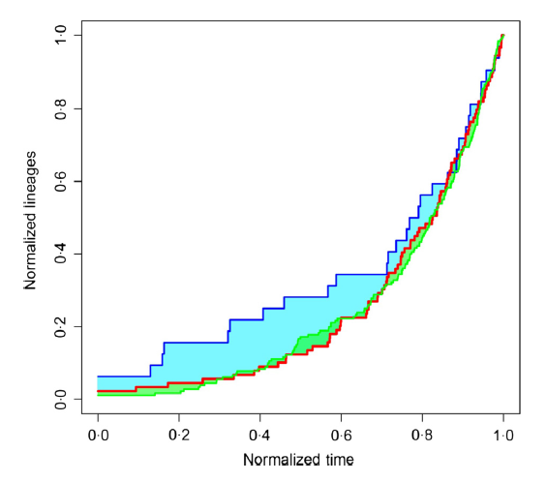
Summary statistics (2)
Lineages through time (LTT) plot
Normalized lineages through time (nLTT) summary statistic
Janzen, T. et al. 2015. Approximate Bayesian Computation of diversification rates from molecular phylogenies: introducing a new efficient summary statistic, the nLTT. Methods in ecology and evolution 6, 5: 566-575.
Notes:
1.The nLTT plot gives the number of lineages in a phylogeny over time. Give example of tree and plot.
2.The nLTT summary statistic is used to compare phylogenetic trees.
3. By normalizing the LTT curves both in number of lineages and in time
((dividing the number of lineages by the number of extant tips and the time by the time to the
most recent common ancestor.))

Slide 13

Assumptions
- Allopatric scenario: no migration, best comparable to PBD
- For each species, two alleles are used in the model
- No advantages or disadvantages for certain alleles
- Same mutation rates for different alleles
- Can be expanded in later stages
Notes:
1. Start to create the BDM-model in an allopatric scenario without migration and without advantages or disadvantages for certain alleles. The allopatric speciation seems in my opinion the closest to the PBD-model
2. Number of alleles used for number of species, example in figure
3. The mutation rates will be the same for different alleles in the model. In this way I start with a relative simple scenario that perhaps can be expanded in the later stages of the project.
4. Effects implementation of backward mutation

Slide 14
Discussion
Mechanistic model
Differences and similarities PBD & BDM
Notes:
1. I expect that the BDM-model will give a more realistic view on the speciation process in compare with the PBD-model, because species with an inviability of hybrids show the mechanisms of the BDM model in a real biological context, however still includes same idea of a gradual mechanism of speciation as seen in the PBD-model
2. More individual based perspective with the use of a genetic background of genotypes to explain the speciation process.
3. Ecological and sexual selection model another example of mechanistic model, parallel project Kees
4. Backward mutation process could increase number of good species, no other differences expected, similar populations size used

Slide 15
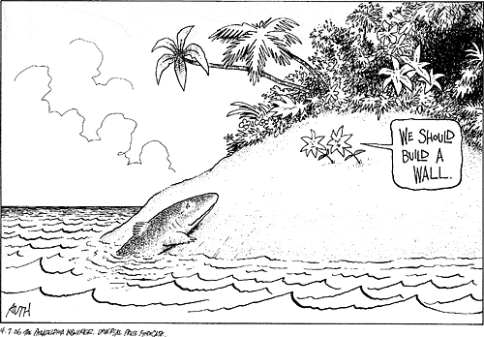
Thank you for
your attention!
Questions?

